Slide 1
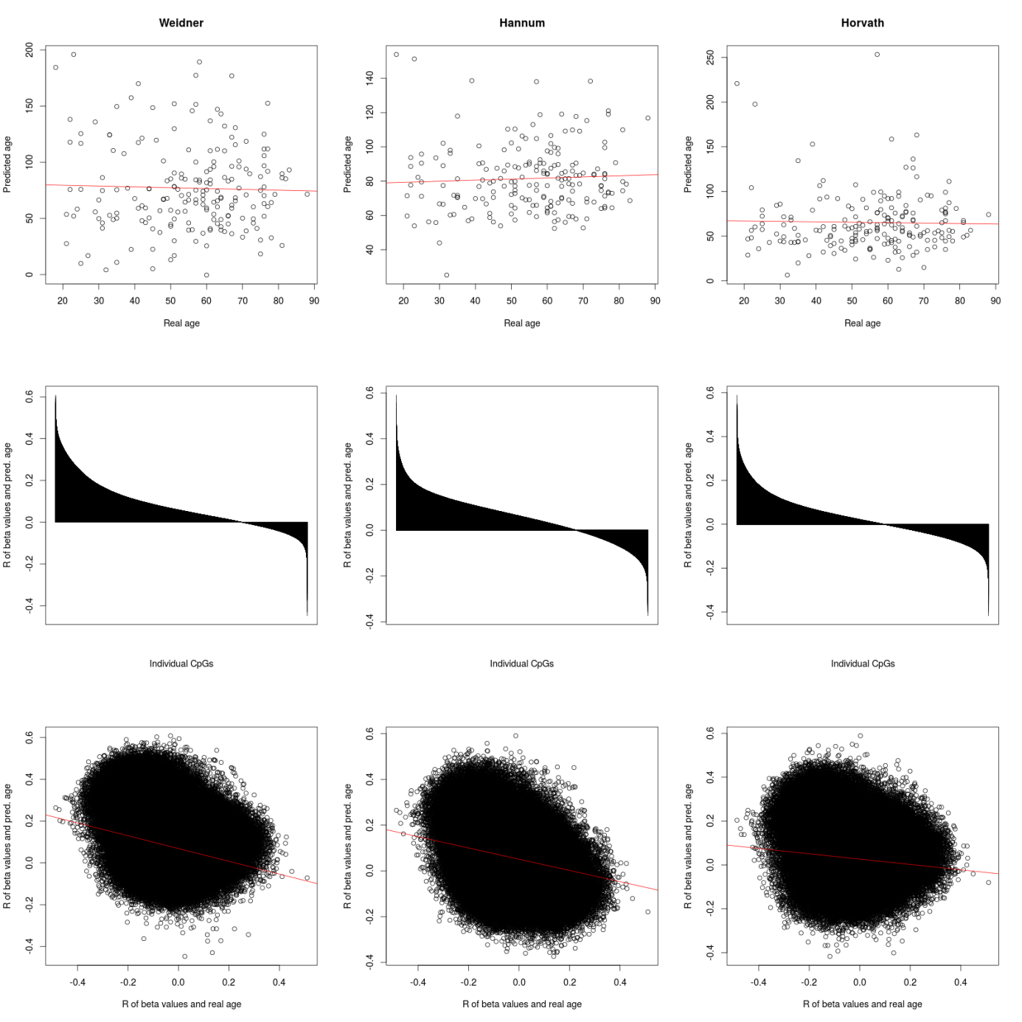
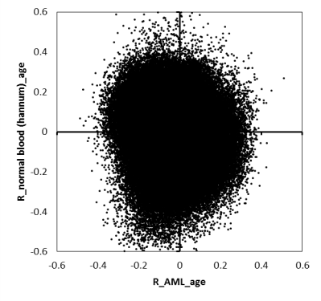
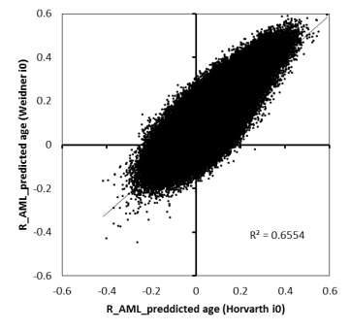
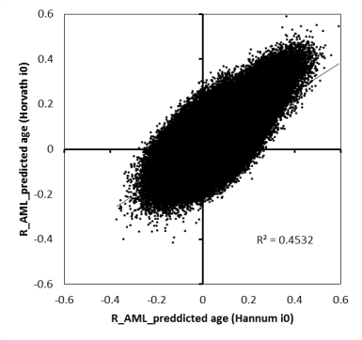
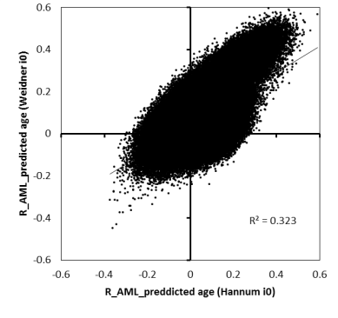
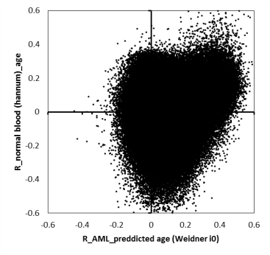
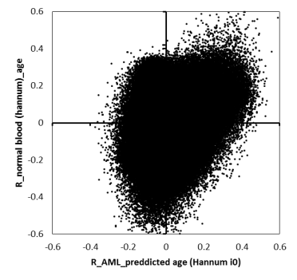
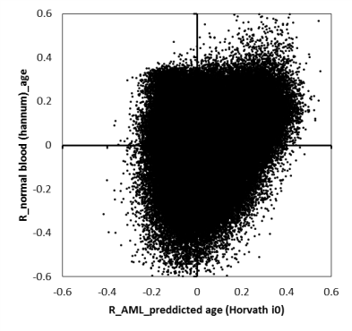
R_normal blood (hannum)_age means the correlation of each CpG with chronological age in the Hannum datasets
R_normal blood (hannum)_age means the correlation of each CpG with chronological age in the Hannum datasets
Perhaps we should reproduce this data on an independent datasets for the supplement?
e.g. 62 cytogenetic normal AML (CN-AML) samples (GSE58477)
Qu Y, Lennartsson A, Gaidzik VI, Deneberg S, Karimi M, Bengtzen S.
Differential methylation in CN-AML preferentially targets non-CGI regions
and is dictated by DNMT3A mutational status and associated with
predominant hypomethylation of HOX genes. Epigenetics. 2014;9:1108–19.
Messages:
In AML the age-predictions by all three models did not give accurate results for chronological age
CpGs that reveal a good correlation with chronological age in normal blood (R>0.4) do not reveal good correlation with chronological age in LAML datasets – thus, there are no genomic regions that preserve age-association.
Using two different predictors the correlation of beta-values with age-preditions were very similar – thus, these age-associated DNAm patterns are coherently modified. (other two combination of sigantures may be presented in the supplement)
Almost all CpGs that reveal positive correlation with predicted age in each of the three models are also hypermethylated in normal aging – thus, particularly hypermethylated CpGs are co-regulated with epigenetic age-predictions

Slide 2
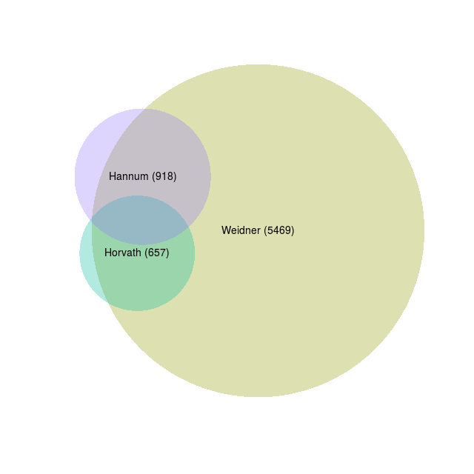
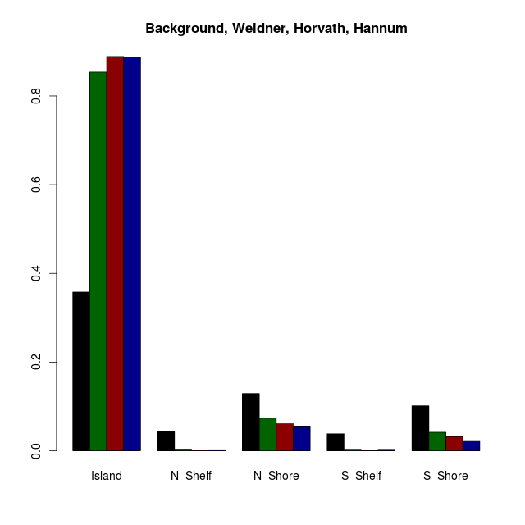
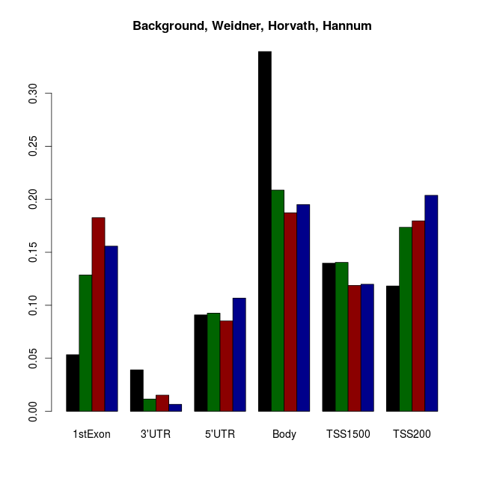
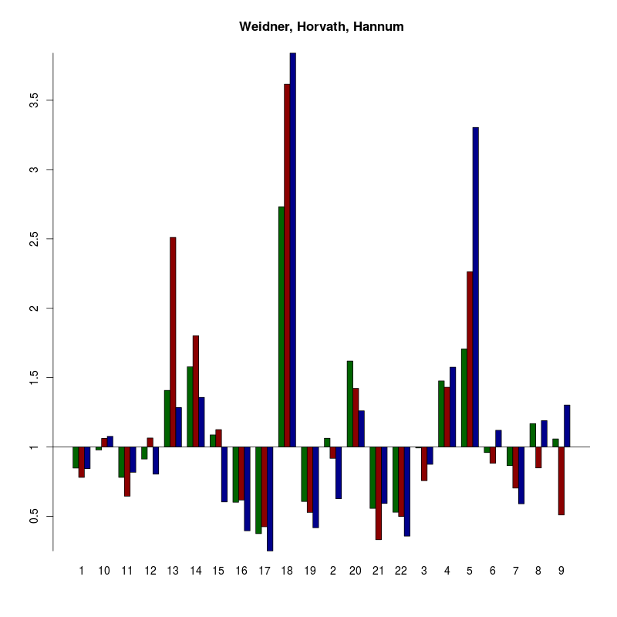
Perhaps we should also include the enrichment of normal age-associated CpGs (CpGs in that reveal correlation with chronological age in the Hannum datasets of R>0.4)?
We need P-values.
Please include “open sea” for CpGs that are not related to any CGI
Please include “intergenic” for genes that are not related to any genes
We should reorder the categories (I might do this in EXCEL if the data is in a suitable table)
(263)
We should reorder chromosomes.
If possible, let´s also have a look for enrichment in chromosomal regions – rather than enrichment in chromosomes
GO, TF-binding motives, and association with histone code can perhaps only be performed with 263 CpGs in the overlap?
Enrichment in TF binding sites
MOTIVES
Enrichment in miRNA binding sites???
Association with histone code?
Reference might be unsorted blood? Preferentially CD34+ hematopoietic stem and progenitor cells…
Messages:
There is a high overlap in correlation of individual CpGs with predicted ages in AML using the three different predictors – particularly in hypermethylated CpGs (all of the 263 CpGs hypermethylated in normal age?)
These age-associated coregulations occur particularly in CGIs and shore regions (unlike senescence-associated modifications that are rather appart from CGIs!)… (This association with CGIs is probably even higher for these cancer co-correlated CpGs than for age-associated CpGs in normal blood)
The modifications are particularly in promoter regions
Many of these genes are associated with development
There are specific TF binding motives close to CpGs that reveal coregulation… (this needs to be redone with the right tools. Please note that FOXO4 might be interesting as FOXmotives are enriched in LaminB1 binding sites and have been associated with life extension (Talks of Irina Bochkis and Ashley E. Webb at keystone)
There seems to be association with the histone code.

Slide 3
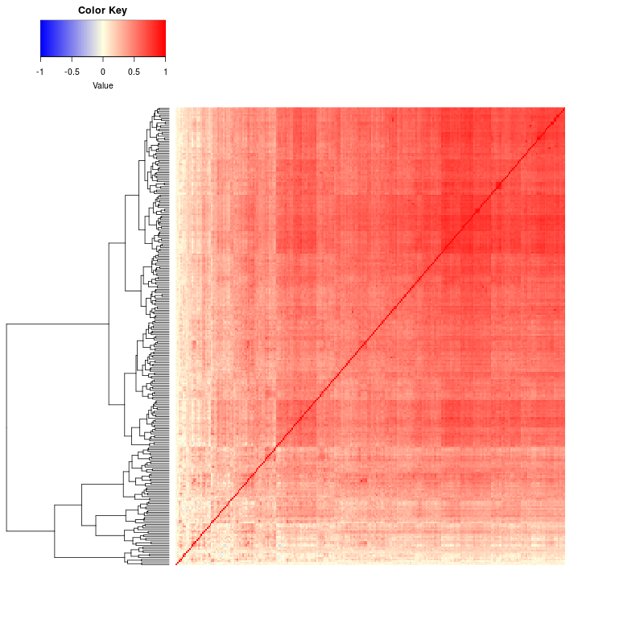
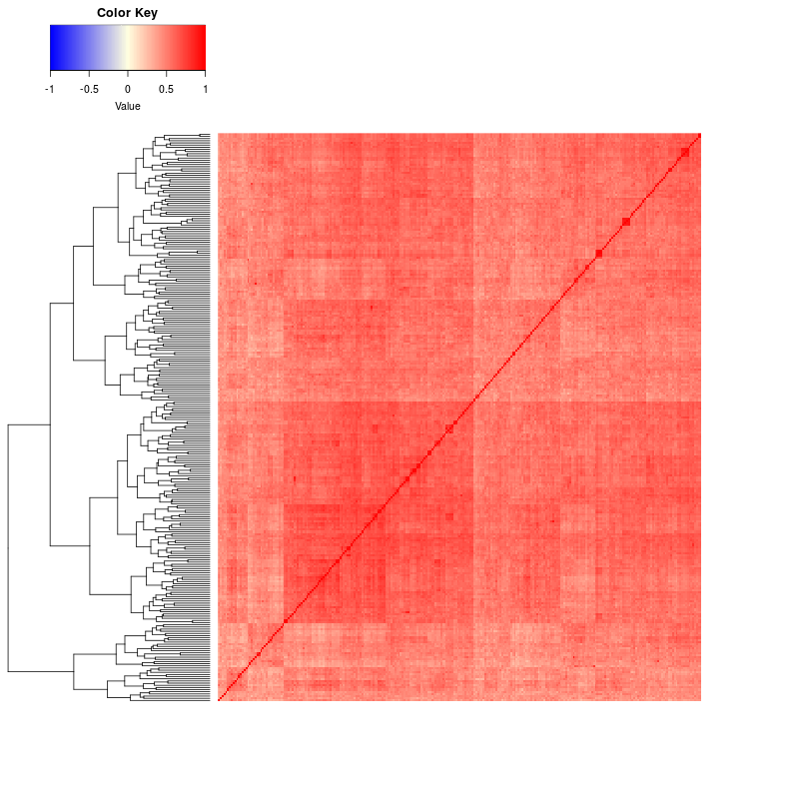
supplemental figure
Message:
Many CpGs are co-correlated and may therefore be redundant in the signatures
Hannum
AML
CpG vs CpG correlation comparison (using the beta values in hannum dataset or laml datset). So a red cell means that the two cpgs correlate perfectly with each other; a blue cell means they inversely correlate (perfectly).

Slide 4
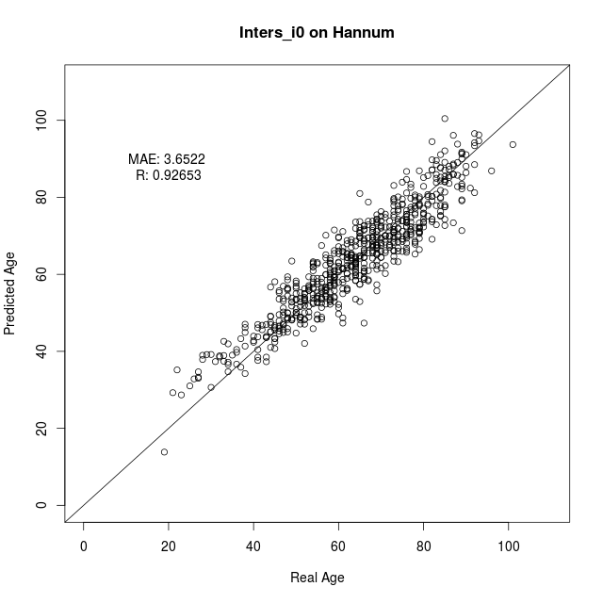
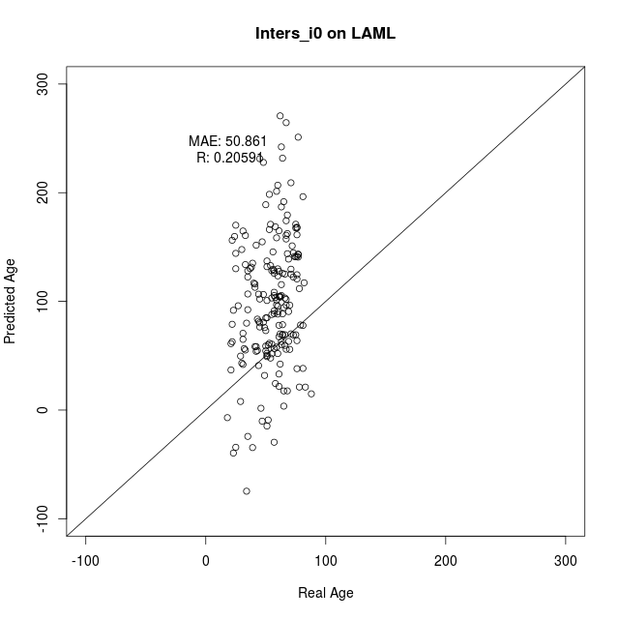
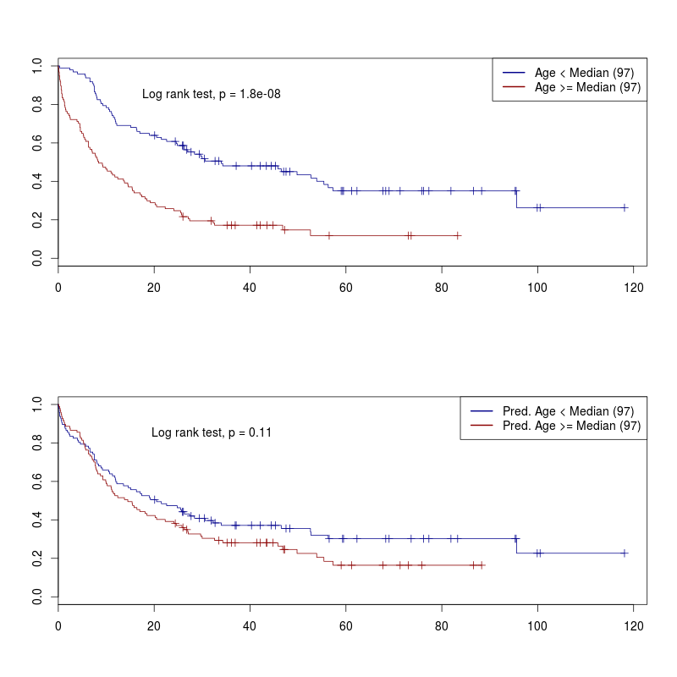
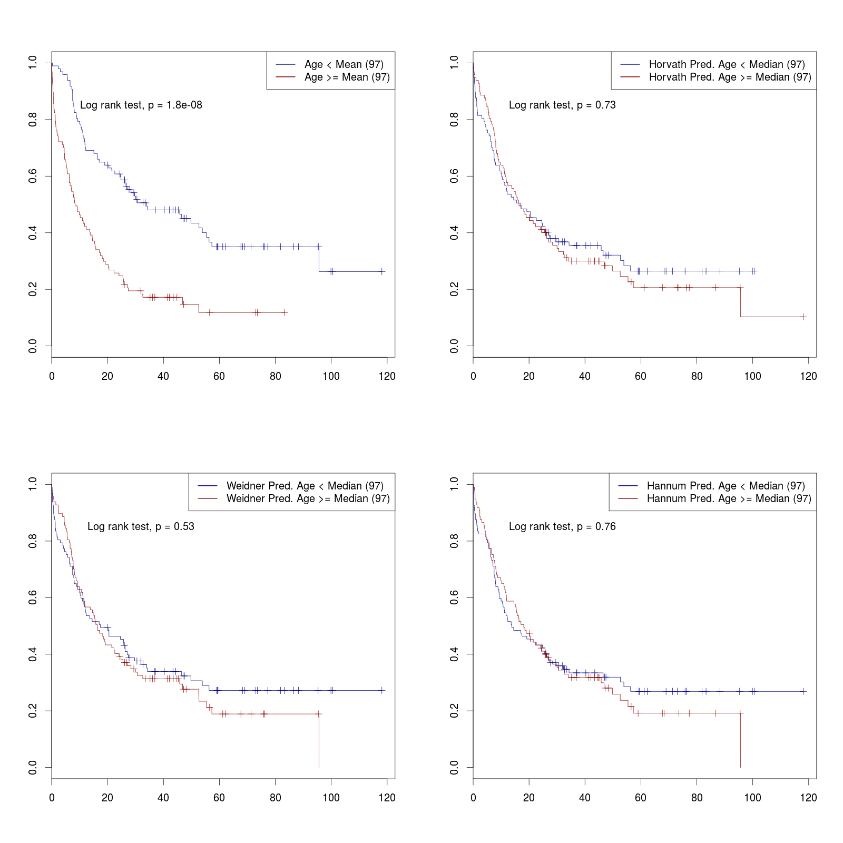
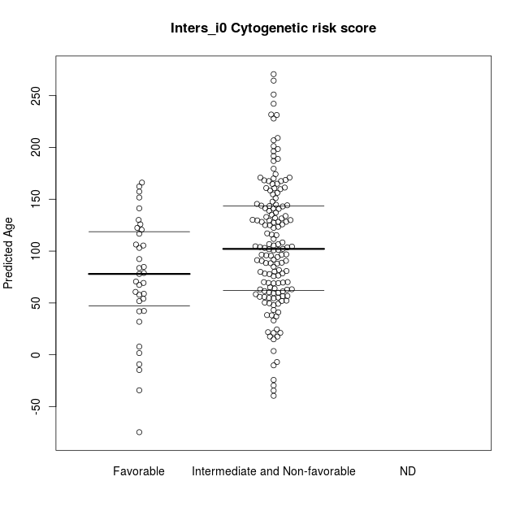
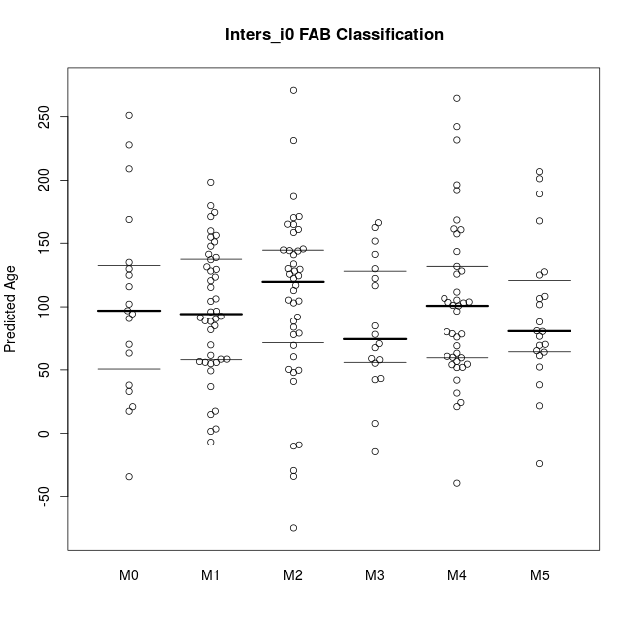
(OR we train on the predicted ages in LAML dataset using the mean of all three age-predictors?... Would this make sense ? This way we would not need to take the artifical step back to normal blood and might still focus on the relevant hypermethylated CpGs… I assume that this might give much better results; Several authors recently used a mean of Hannum andHorvarth predictor – thus it is not far of) and then use this for association with:
- AML subtype, gender, mutations, KM-plots; and Cox-regression analysis.
COX Model might be informative (adjusted for age and gender).
Validation in other AML datasets:
Karolinska,
AML Halle
AML-AZA
…another on that Tanja downloaded…
?? Test signature on other tumors? Similar to table 1 in Lin and Wagner PLoS Genetics…. If then we ask Qiong

Slide 5
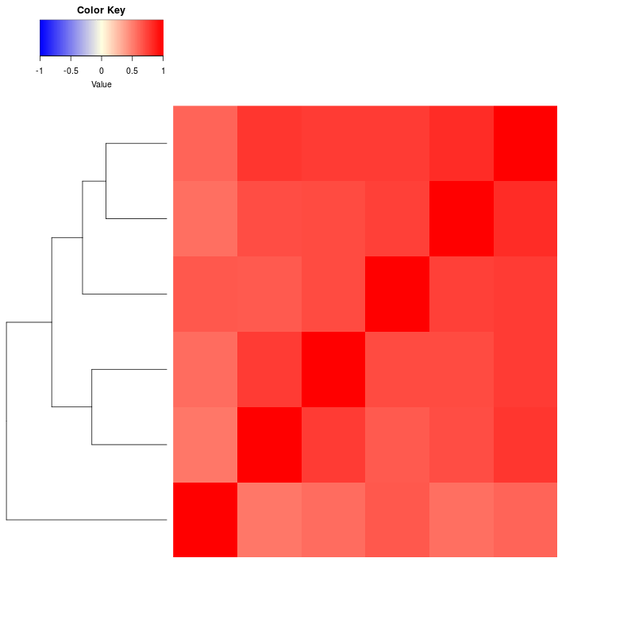
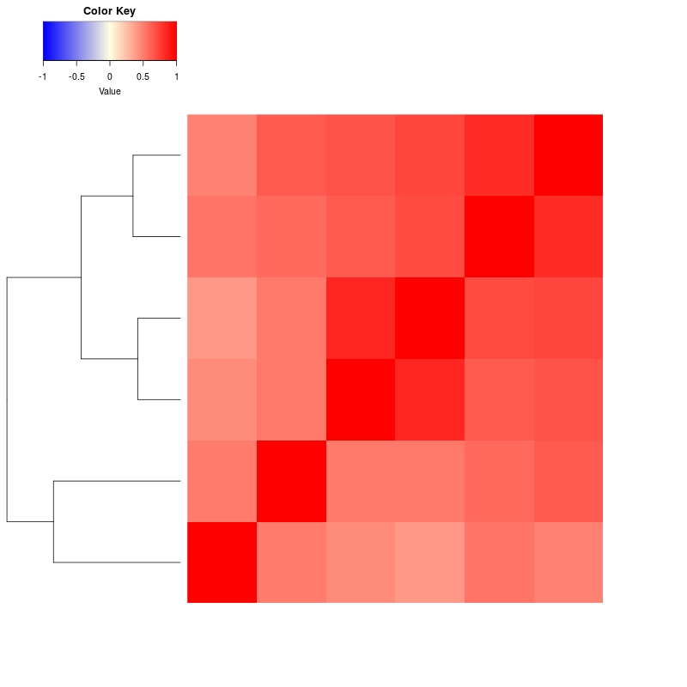
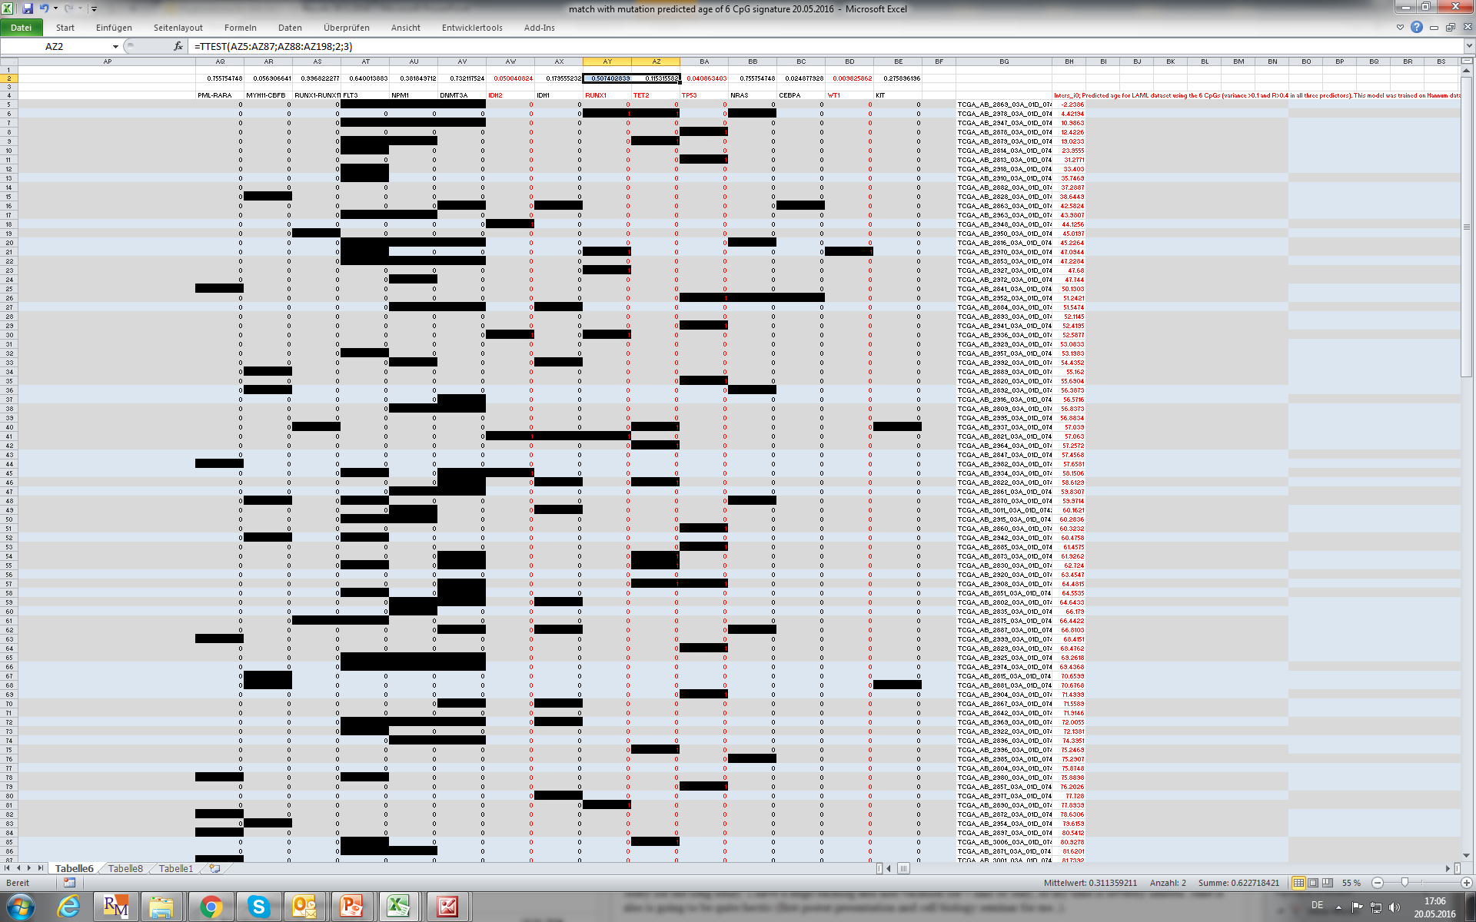
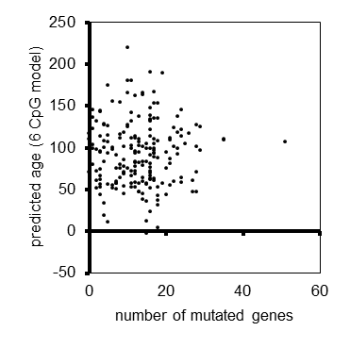
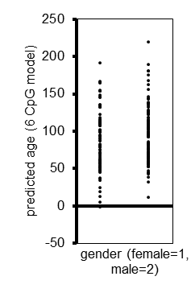
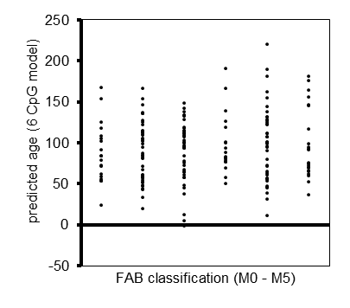
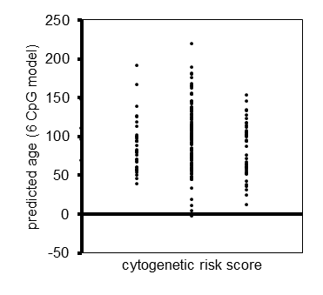
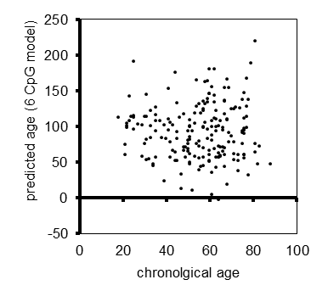
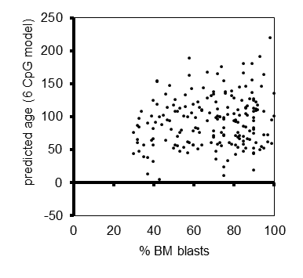
Alternatively: R>0.4 in all predictors and variance >0.1
CpG_ID | CHR | MAPINFO | Probe_SNPs | Probe_SNPs_10 | Methyl27_Loci | UCSC_RefGene_Name | UCSC_RefGene_Group | UCSC_CpG_Islands_Name | Relation_to_UCSC_CpG_Island | R_laml_age | R_hannum_age | Mean_laml | Variance_laml | Mean_hannum | Variance_hannum | R_weidner_i0 | R_horvath_i0 | R_hannum_i0
cg04100532 | 2 | 210636560 |  |  | NA | UNC80;UNC80 | TSS200;TSS200 | chr2:210636344-210636935 | Island | -0.16427284 | 0.20330189 | 0.32098945 | 0.10576592 | 0.11432058 | 0.0037366 | 0.49685134 | 0.54398557 | 0.42743361
cg12832313 | 5 | 140346236 |  |  | NA | PCDHAC2;PCDHAC2;PCDHA7;PCDHA12;PCDHA6;PCDHA10;PCDHA4;PCDHA11;PCDHA8;PCDHA6;PCDHA1;PCDHA2;PCDHA1;PCDHA9;PCDHA13;PCDHA5;PCDHAC1;PCDHA3;PCDHAC2;PCDHA10 | 1stExon;TSS200;Body;Body;Body;Body;Body;Body;Body;Body;Body;Body;Body;Body;Body;Body;Body;Body;5'UTR;Body | chr5:140346105-140346931 | Island | -0.27025935 | 0.15136646 | 0.36783097 | 0.10083642 | 0.07033917 | 0.00166144 | 0.42967872 | 0.4016033 | 0.4537044
cg15015920 | 5 | 16179873 |  |  | NA | MARCH11;MARCH11 | 1stExon;5'UTR | chr5:16179064-16180420 | Island | -0.12681357 | 0.38359363 | 0.40660811 | 0.10211886 | 0.07171172 | 0.00127925 | 0.48991384 | 0.41503289 | 0.55752035
cg17712694 | 5 | 16180068 |  |  | NA | MARCH11 | TSS200 | chr5:16179064-16180420 | Island | -0.13739726 | 0.26099074 | 0.53866479 | 0.10293537 | 0.09971866 | 0.0030073 | 0.4740304 | 0.4172928 | 0.47738821
cg21901718 | 5 | 16180076 |  |  | NA | MARCH11 | TSS200 | chr5:16179064-16180420 | Island | -0.18621951 | 0.15120857 | 0.37916698 | 0.10788631 | 0.02870969 | 0.0007064 | 0.49488892 | 0.42238128 | 0.46444018
cg25092681 | 5 | 16180033 |  |  | NA | MARCH11 | TSS200 | chr5:16179064-16180420 | Island | -0.16279894 | 0.22799394 | 0.33209898 | 0.10286631 | 0.02426104 | 0.00073495 | 0.46942019 | 0.41468939 | 0.5031199
Co-correlation of the six selected CpGs in the Hannum dataset
Co-correlation of the six selected CpGs in the LAML dataset
Ad lables of the CpGs
Probably we will only use three CpGs – because four of them are in the same gene. Might be that it is the three CpGs on the bottom… if so, then we would retrain a 3 CpG model i0 for further analysis with clinical data
We should train an age-predictor for the 3 CpGs on the Hannum Dataset (OR we train on the predicted ages in LAML using the mean of all three age-predictors?) and then use this for association with:
- AML subtype, gender, mutations, KM-plots; and Cox-regression analysis.
WT1 mutations are significantly more frequent in patients that are predicted below median age by 6 CpGs:
TP53 mutations are significantly more frequent in patients that are predicted above median age by 6 CpGs:

